Slide 1
MINORITY CARRIER DISTRIBUTION & TERMINAL CURRENT

Slide 2
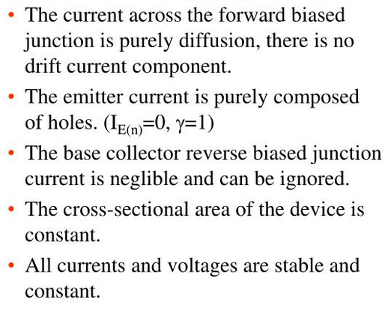
QUANTATIVE ANALYSIS OF BJT
BASIC ASSUMPTION CONSIDERED:-

Slide 3
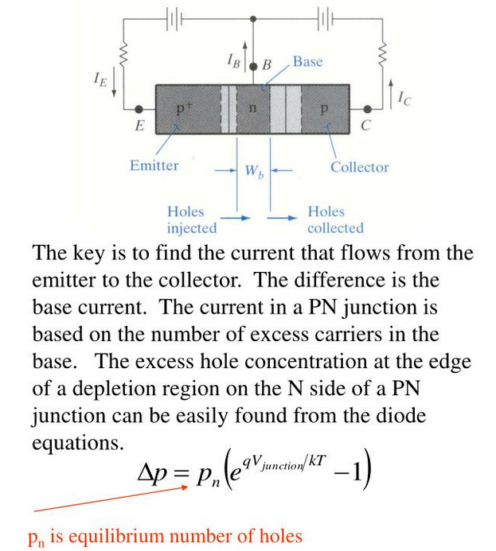

Slide 4
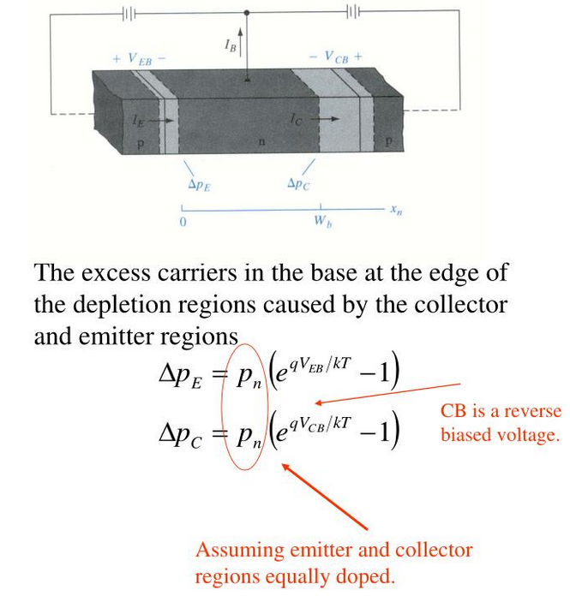
SOLUTION OF DIFFUSION EQUATION IN THE BASE REGION

Slide 5
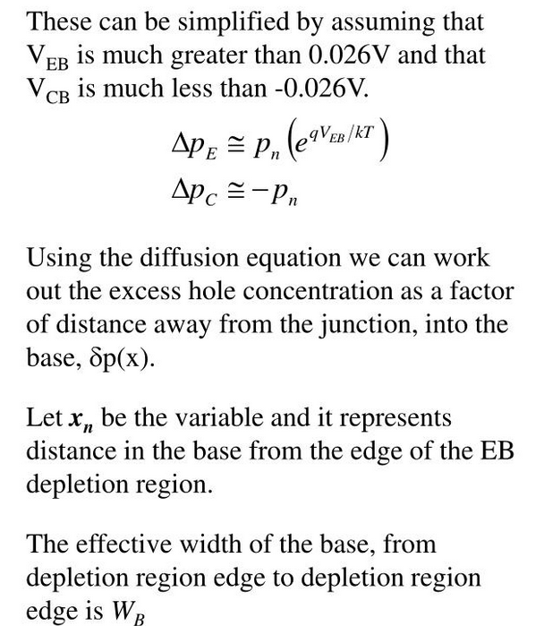

Slide 6
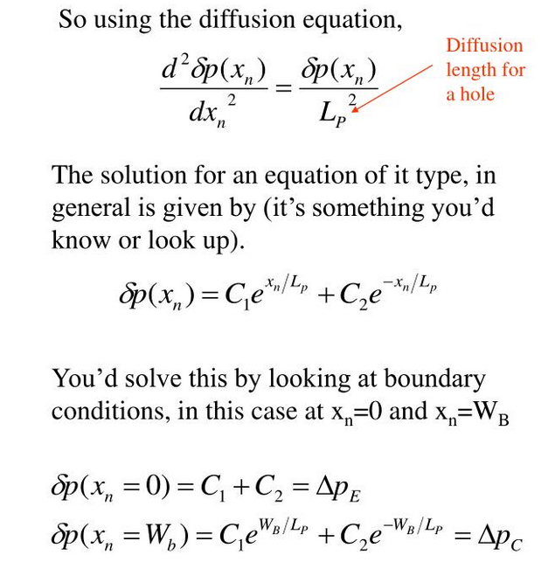

Slide 7
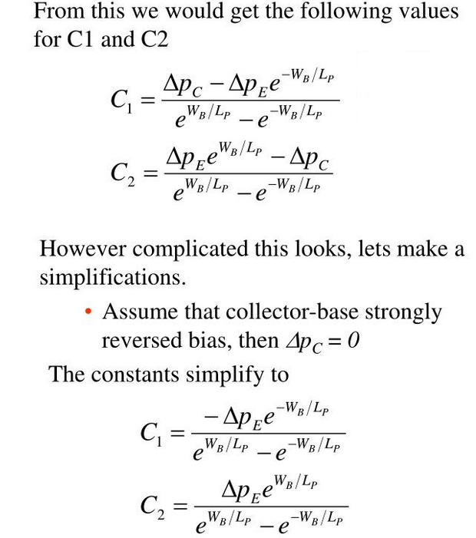

Slide 8
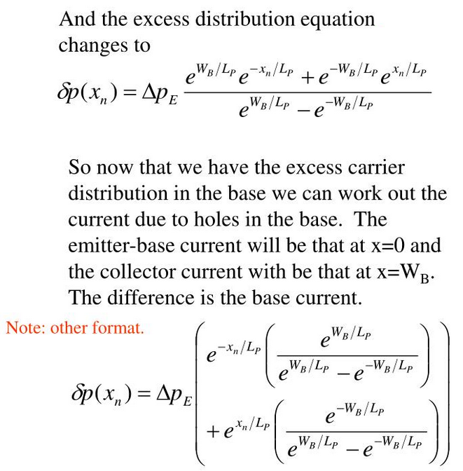

Slide 9
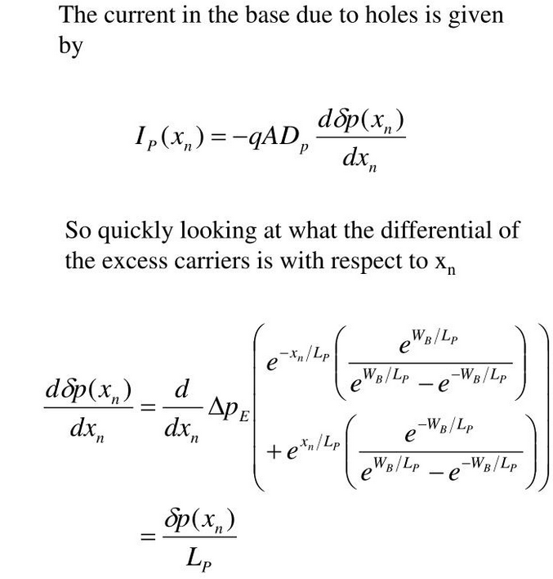
EVALUATION OF THE TERMINAL CURRENT

Slide 10
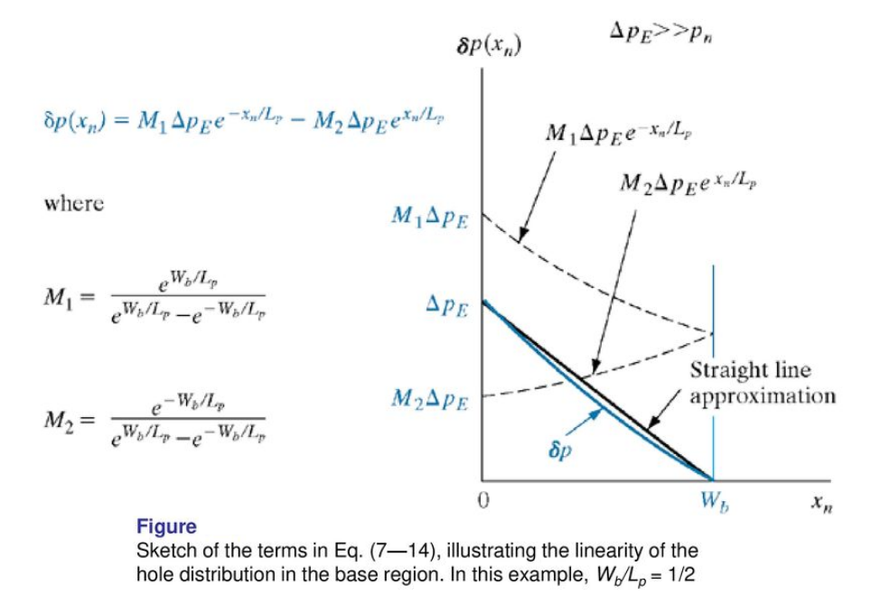

Slide 11
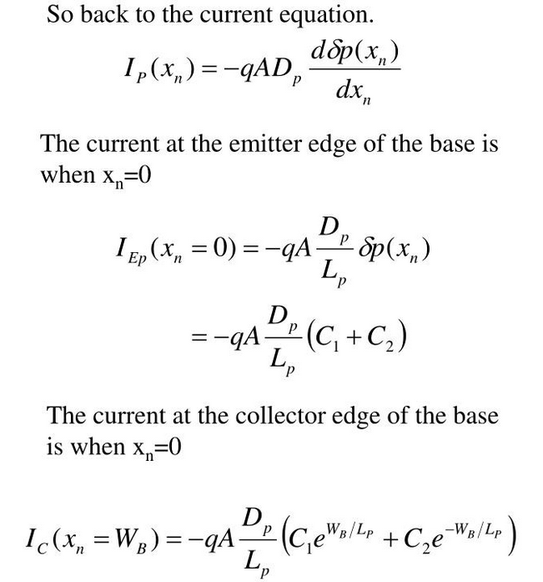

Slide 12
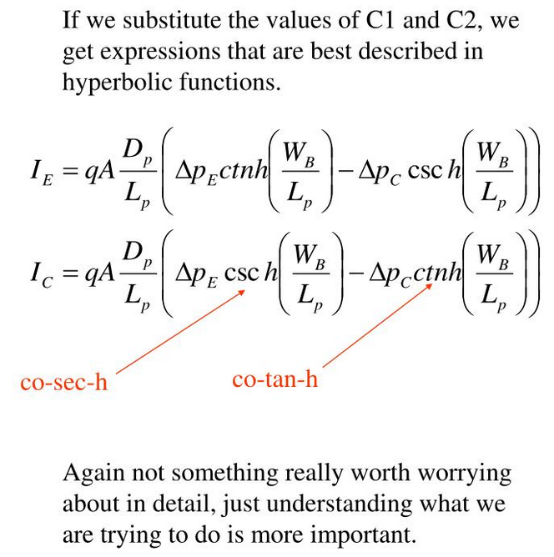

Slide 13
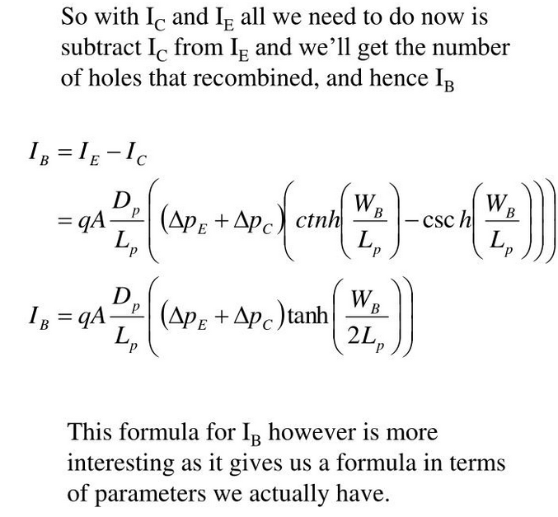

Slide 14
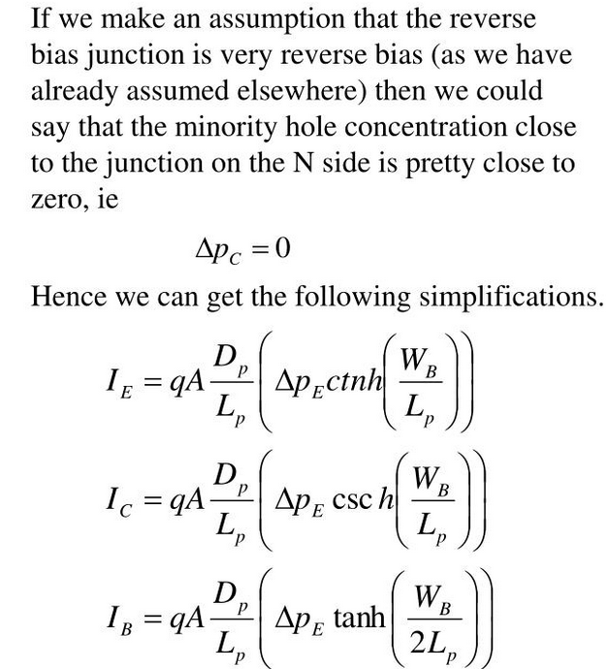
APPROXIMATION OF TERMINAL CURRENTS

Slide 15
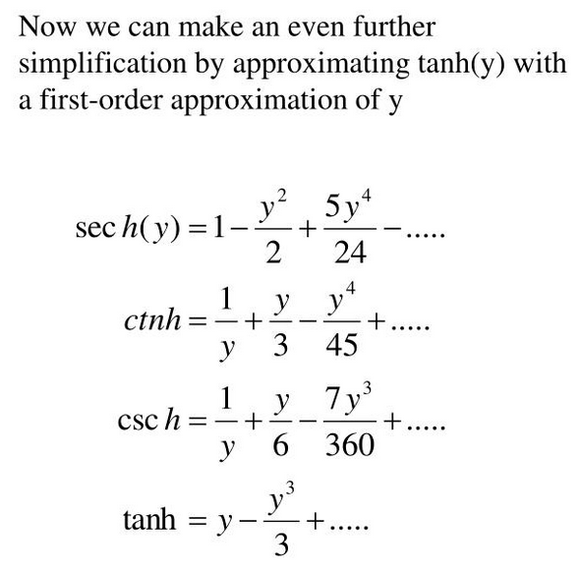

Slide 16
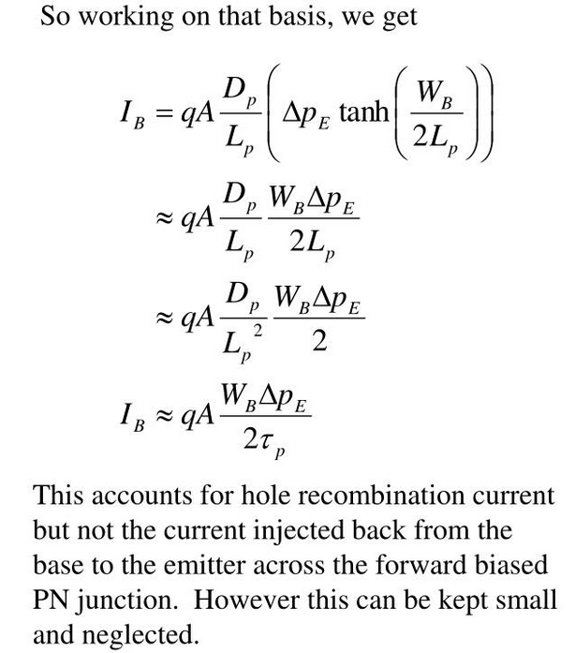

Slide 17
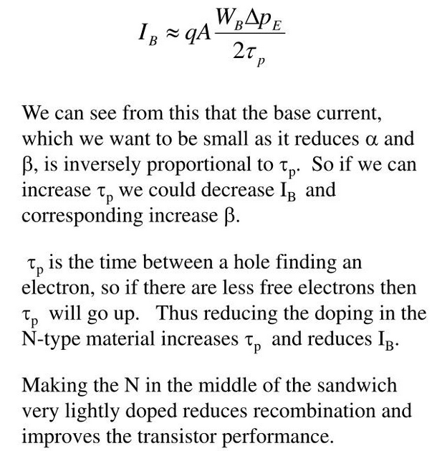

Slide 18
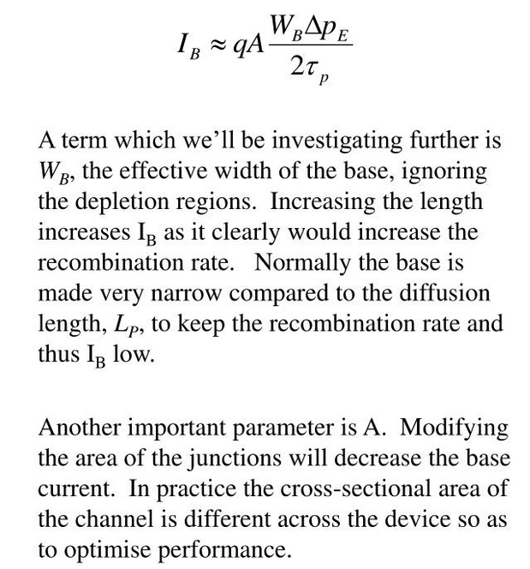

Slide 19
